Slide 1
Helping the Homeless with Qiosk
Developed By Hailey Hultquist, Takondwa Kakusa, James Shao, and Cameron West

Slide 2
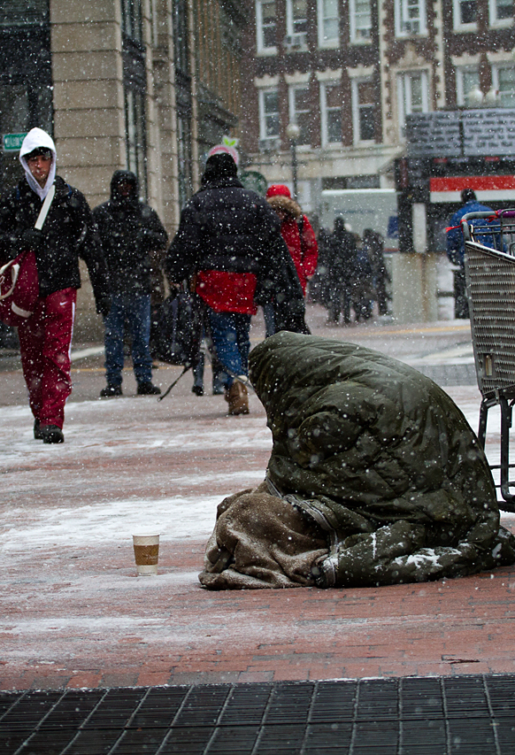
Statistics on the Homeless Population.
In 2016, there were 550,000 Americans that were homeless
Los Angeles and San Diego have the 2nd and 4th highest homeless populations in the nation.
California accounts for 28% of all homeless population
Homeless is caused by the lack of funds and a severe lack of affordable housing

Slide 3
What We Aim To Do.
The goal is to:
Provide accessible, easy-to-use technology for the homeless and underserved to search for jobs and build wealth and reputation.
Provide an Uber-esque review system that allows employers and employees to give ratings on a per job basis.
Providing underserved populations information on resources such as financial services, job fairs, community events, hygiene locations, etc.

Slide 4
Our Team Structure
Backend Server:
Takondwa Kakusa
Website / UI Design
James Shao
Android Development
Hailey Hultquist
Embedded Devices
Cameron West

Slide 5
Our Implementation
Backend
Used Django framework which utilizes an SQLite database.
Frontend
Used the Foundation framework with jQuery and Sass styling.
Android Development
Developed in Android Studio to create a prototype app.
Embedded Devices
Researched ability to use DragonBoard to serve as the Qiosk main computer and to provide facial recognition services.

Slide 6
Our Future Vision
Rolling out Qiosks to metropolitan areas that are in the most need for earning income and where businesses might be hesitant.
Implement DragonBoard to be the low-cost computer behind the Qiosk
Implement LTE for remote internet access
Holding Community Events to Hire Low-Skilled Labor and Build Reputation

Slide 7
References
https://www.nlchp.org/documents/Homeless_Stats_Fact_Sheet
https://www.forbes.com/sites/niallmccarthy/2016/11/25/the-u-s-cities-where-the-largest-homeless-pop-infographic/#1dc344c24dde
http://host.madison.com/wsj/news/special/homeless/introducing-the-series-a-challenge-to-move-beyond-stereotypes-and/article_372866d7-3bb9-5690-87e2-1c98b8f58995.html

